Slide 1
Build a basic Connector
Connector Registration

Slide 2

Connector Registration
Connectors Developer Dashboard
Connector Submission Checklist

Slide 3
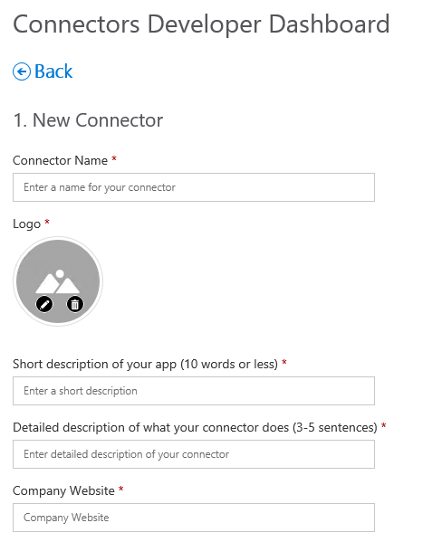
Connectors Developer Dashboard
Register a Connector
New Connector section
Field | Notes
Connector Name | Shown in connector list
Logo | Shown in connector list
Short description | Shown in connector list
Detailed description | Shown when adding / configuring a connector
Company website | Shown when adding / configuring a connector
Notes:
Provide data in well-defined fields. Rendering is handled by host application

Slide 4
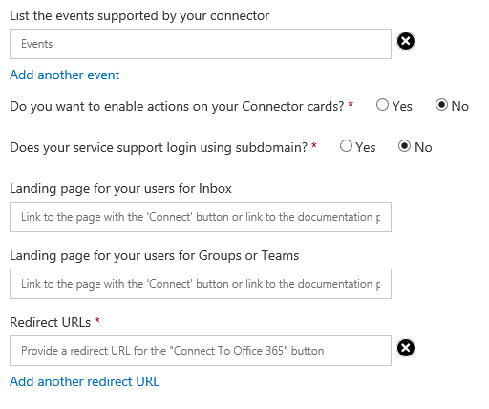
Connectors Developer Dashboard
Register a Connector
New Connector section - continued
Field | Notes
Events supported | Shown when adding / configuring a connector
Enable Actions | Used for Actionable cards
Subdomain | Used for Actionable cards
Landing page(s) | Displayed to user during configuration
Redirect URLs | Page to which configuration data is POSTed.
Notes:
Provide data in well-defined fields. Rendering is handled by host application

Slide 5
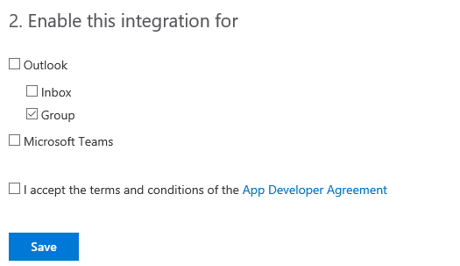
Connectors Developer Dashboard
Register a Connector
Integration section
Field | Notes
Outlook
Inbox | Allows connector to send cards to user’s Inbox
Group | Allows connector to send cards to Group conversations
Microsoft Teams | Allows connector to send cards to conversations in Channels
Notes:
Provide data in well-defined fields. Rendering is handled by host application

Slide 6

Summary

Slide 7
Thank you

